Slide 1

Team: METRICS CHICKS

Slide 2


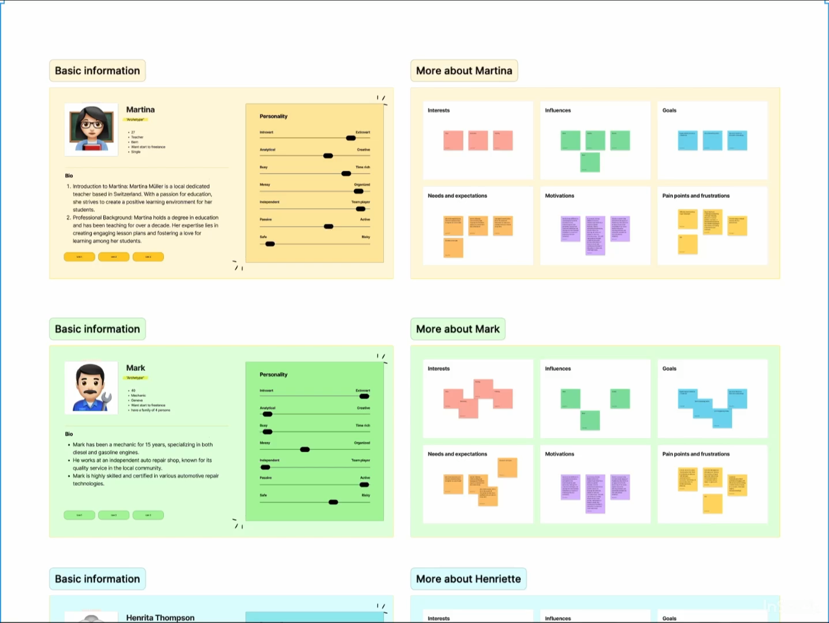
YOUR
SWISS ARMY KNIFE
ON LEGAL WISDOM
Why complicate Swiss law when you can simplify it?
Team: METRICS CHICKS

Slide 3


